Slide 1
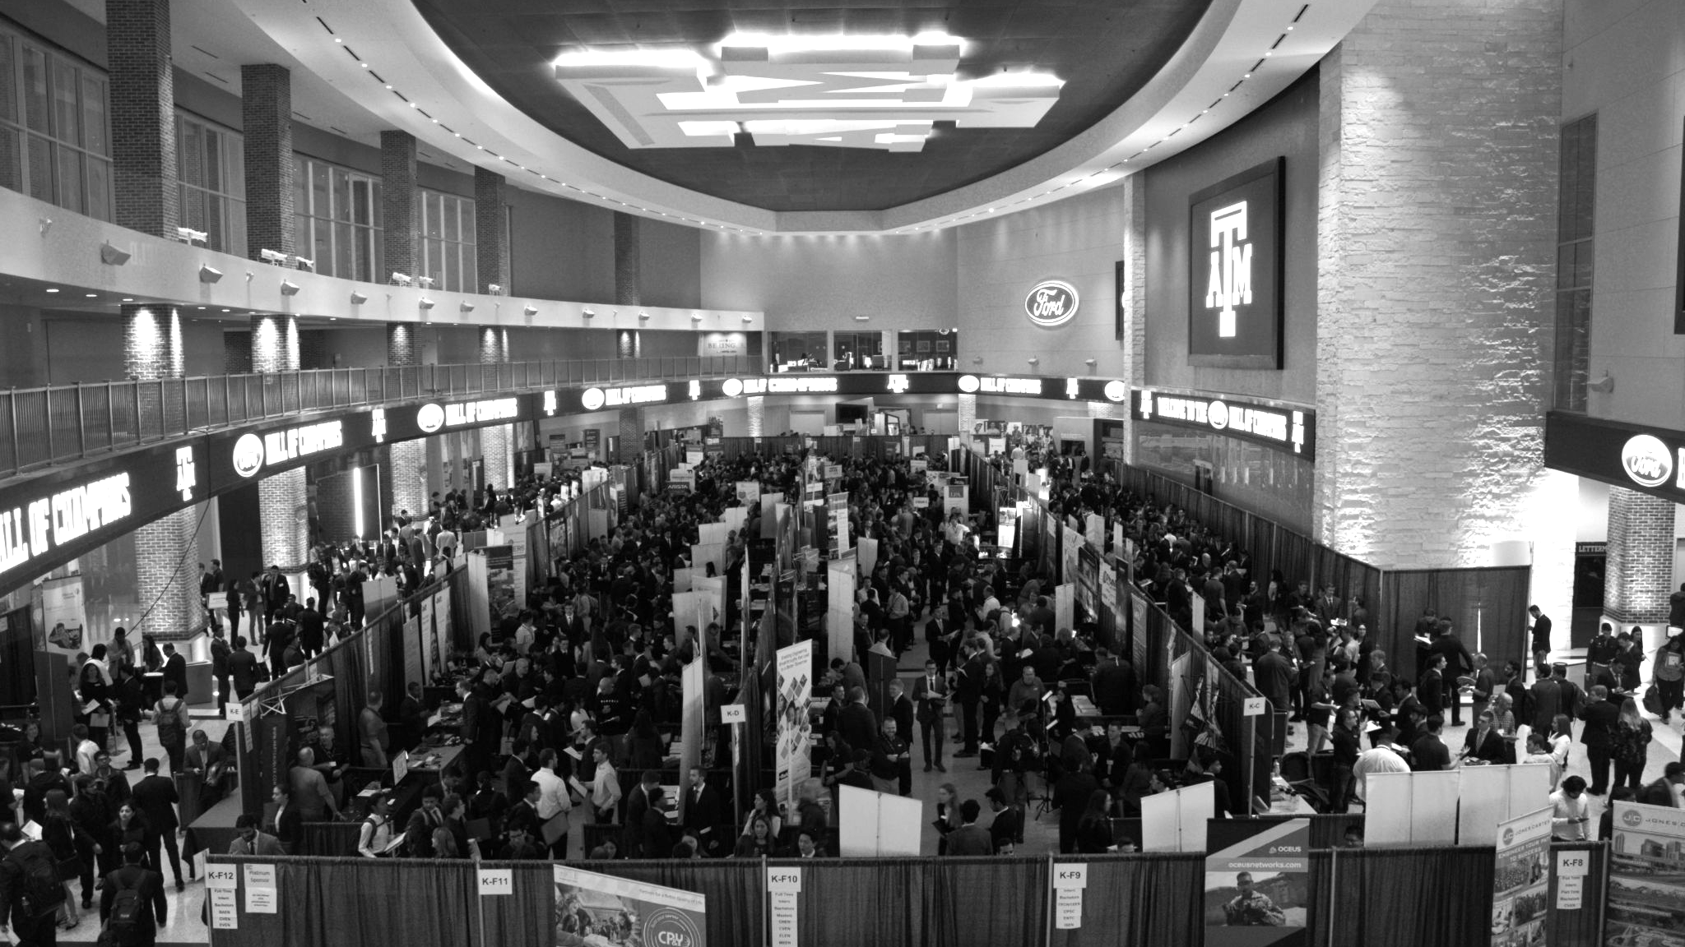

LANL Team Project Update
3/26/2025
Izzy Baumler, Dalton Boeckmann, Morgan Gullo, Jade Waldron

Slide 2
Problem Statement/Project Motivation
There is a need for a technology that has 5 DOF and can move through its full range of motion in each degree of freedom of at least 1 Hz.

Slide 3
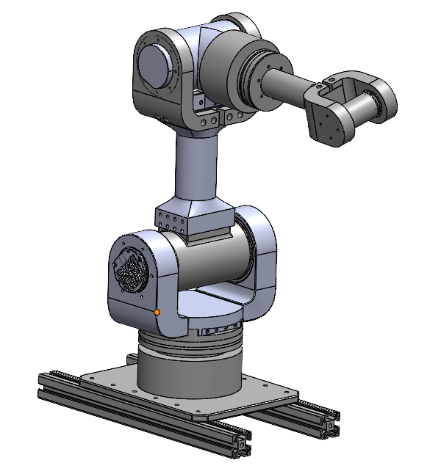
Weekly Assigned Tasks
Jade - Solidworks Refinement/Prototyping/Assembly
Izzy - Motor Research and testing
Dalton - Assembly/Motor Testing
Morgan - Purchase Orders/Electrical

Slide 4
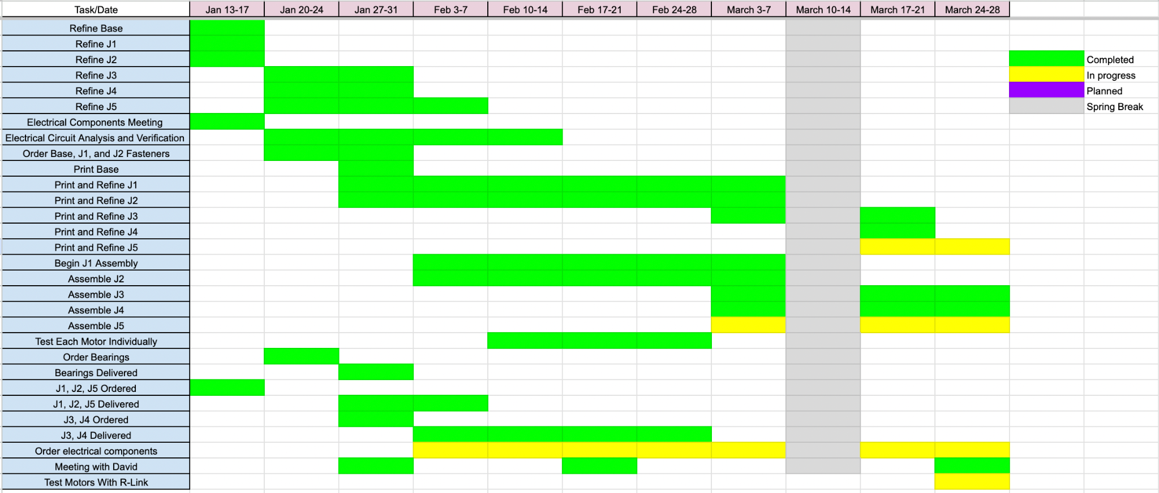
Schedule Update

Slide 5
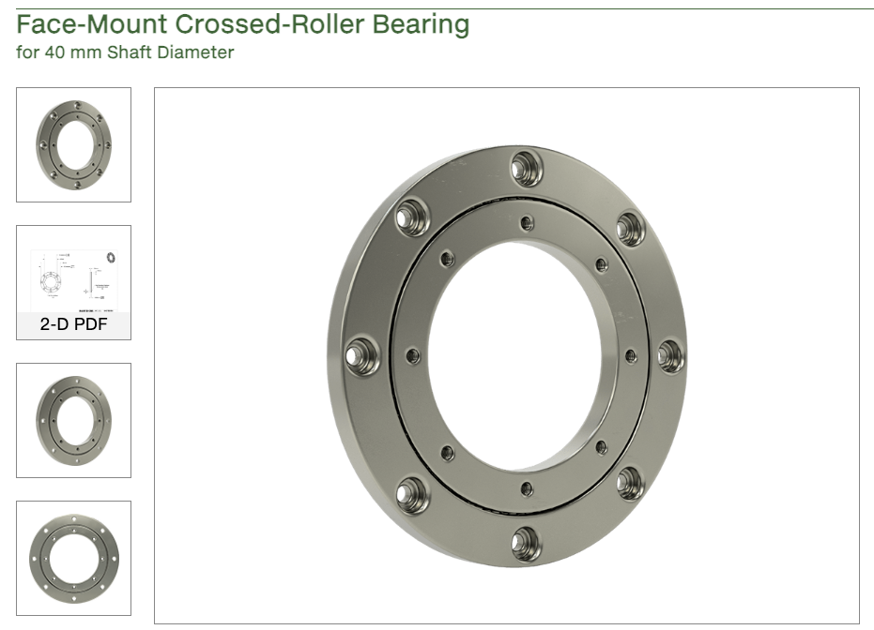
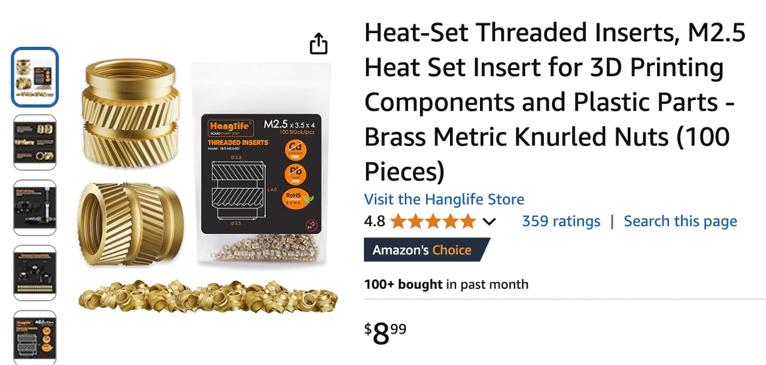
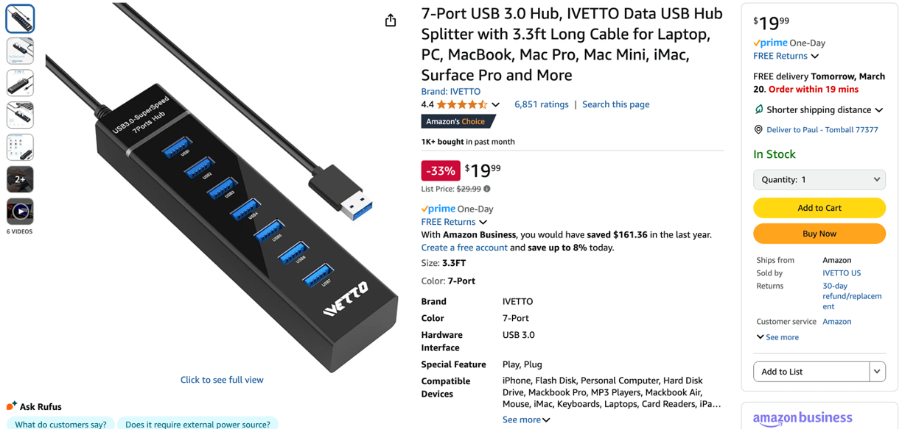
Orders Update

Slide 6
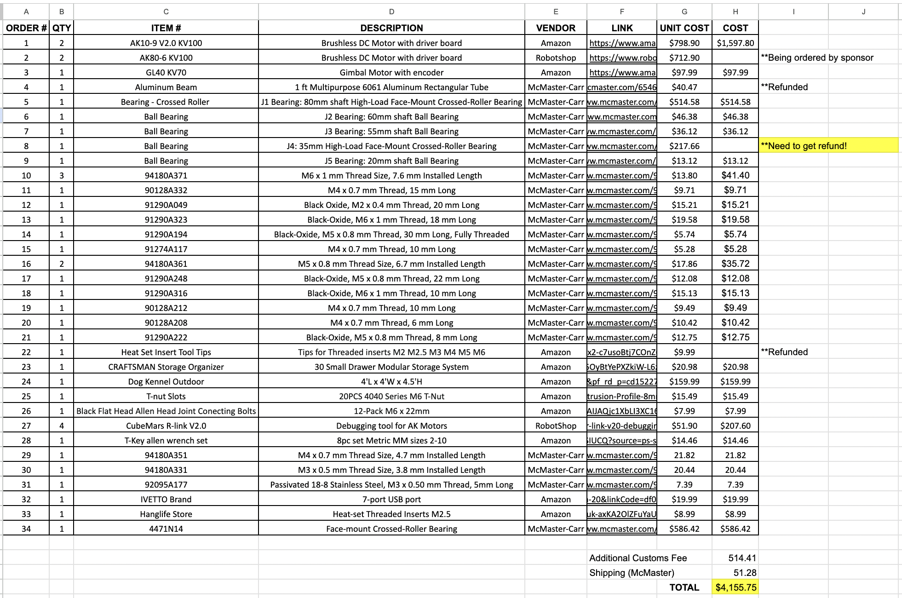
Budget Update

Slide 7
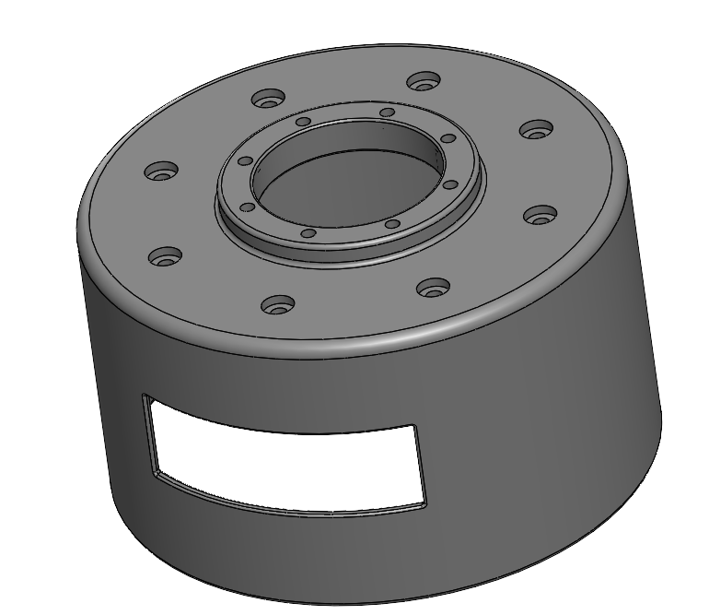
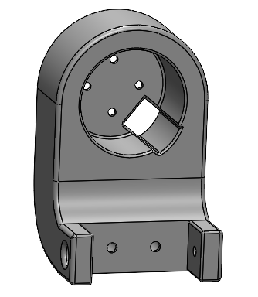
Refinement/Prototyping
J4 Motor Cap
Holes for Motor
Hole for Wiring
J5 Motor and Bearing holder
CAD model is not the same as motor we received

Slide 8
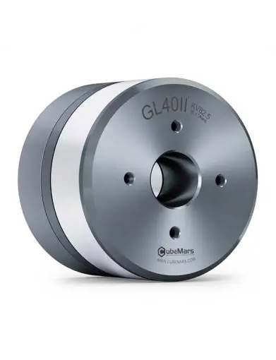
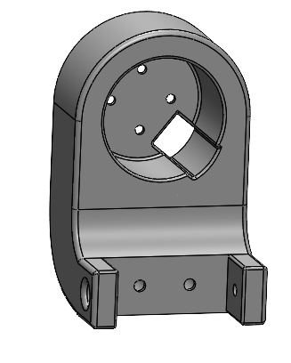
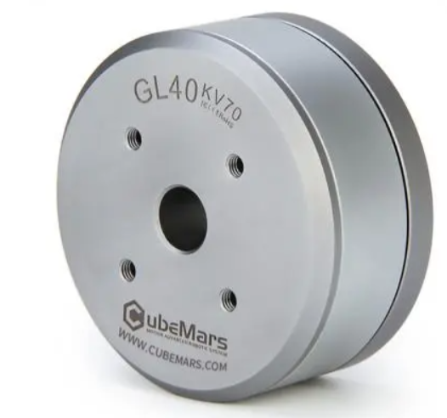
SolidWorks Issue
GL40 KV 70
GL 40 II
~15 mm longer than left motor
Depth adjusted to reflect

Slide 9
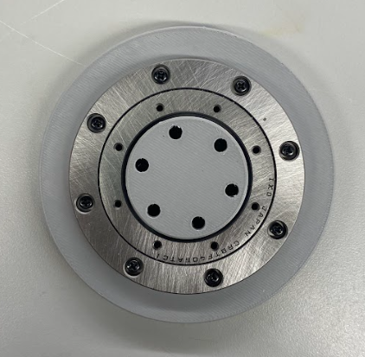
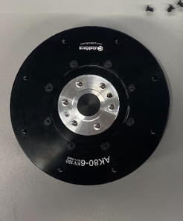
SolidWorks/Bearing Issue
Bearing issue with original bearing
The original bearing diameter was smaller than the shaft of the motor

Slide 10
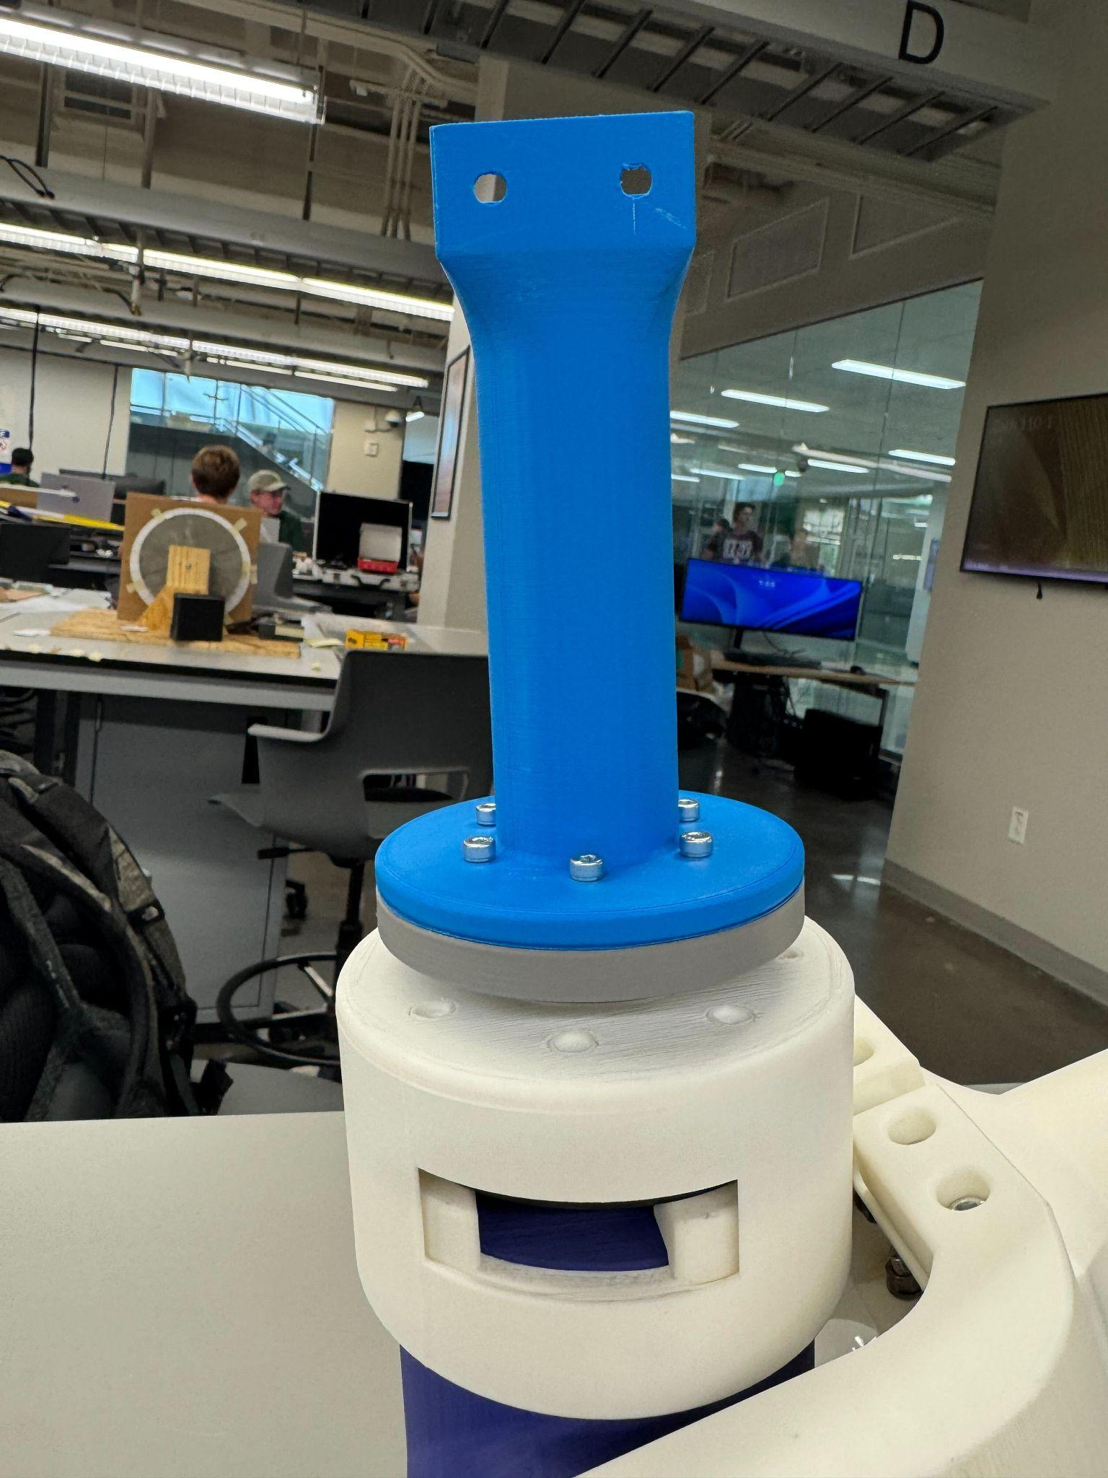
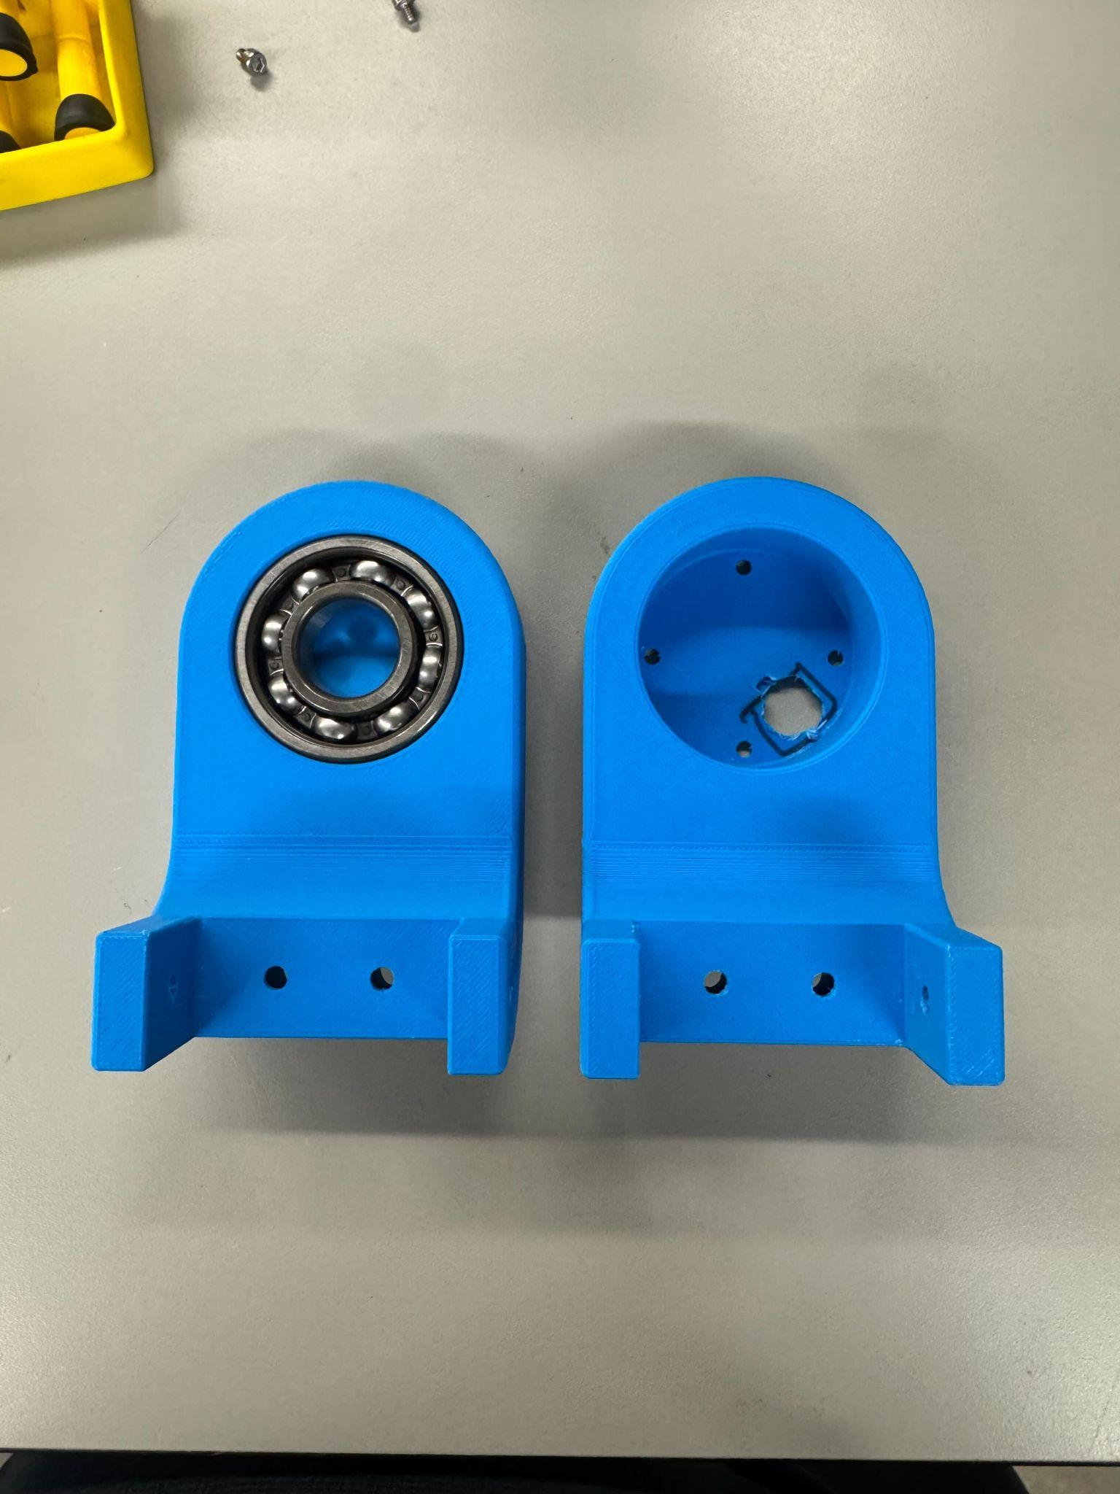
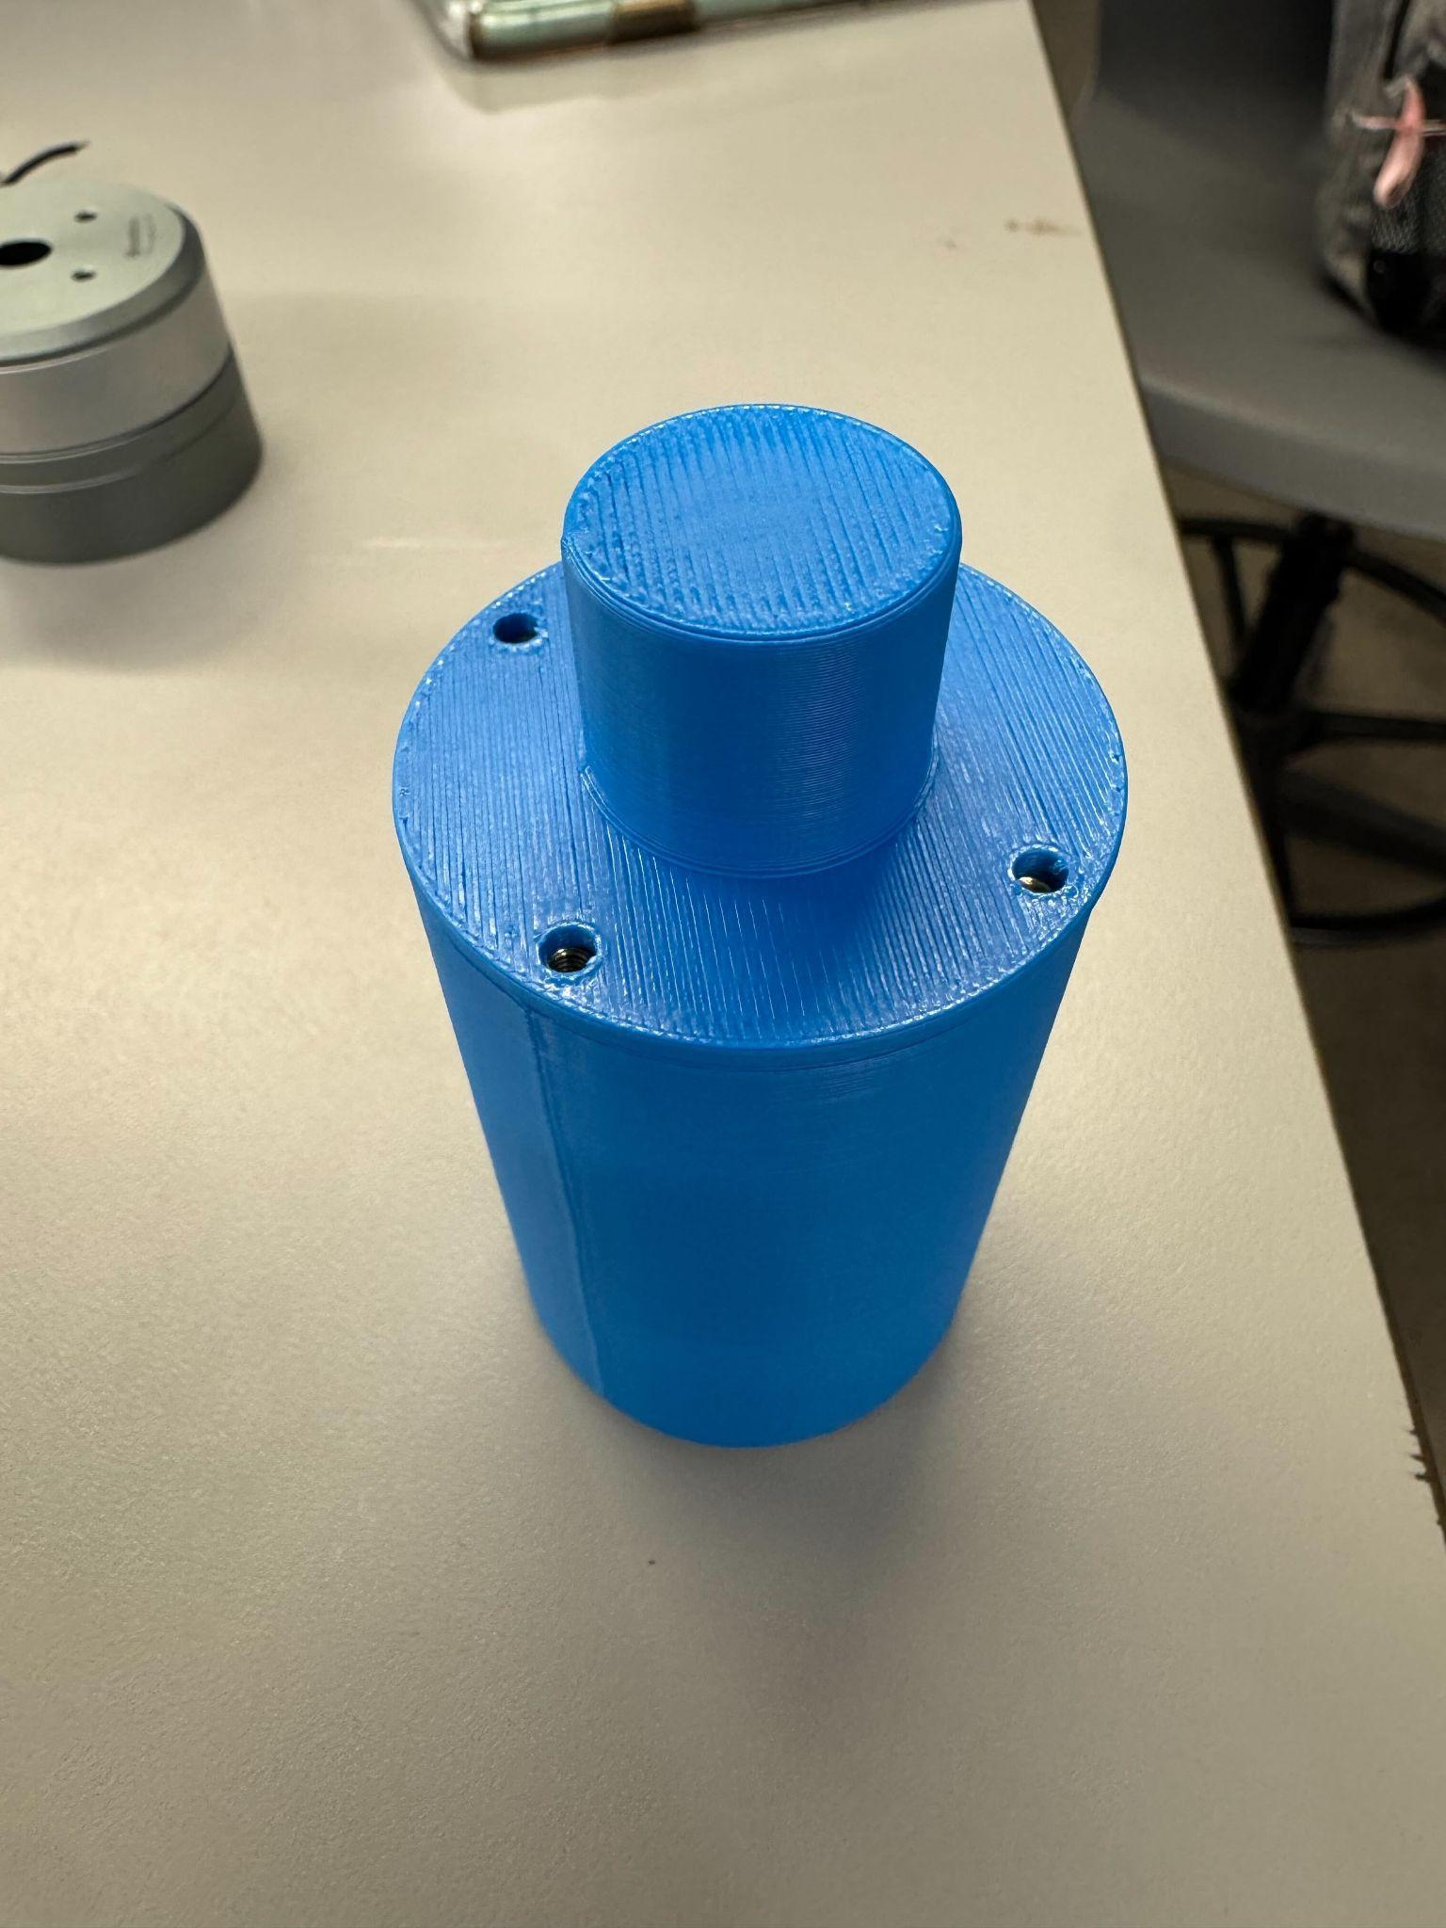
Prototyping
J5 Prototyped
J4 and J5 Soldered Heat set inserts
Color and Filament will stay the same per sponsor request

Slide 11
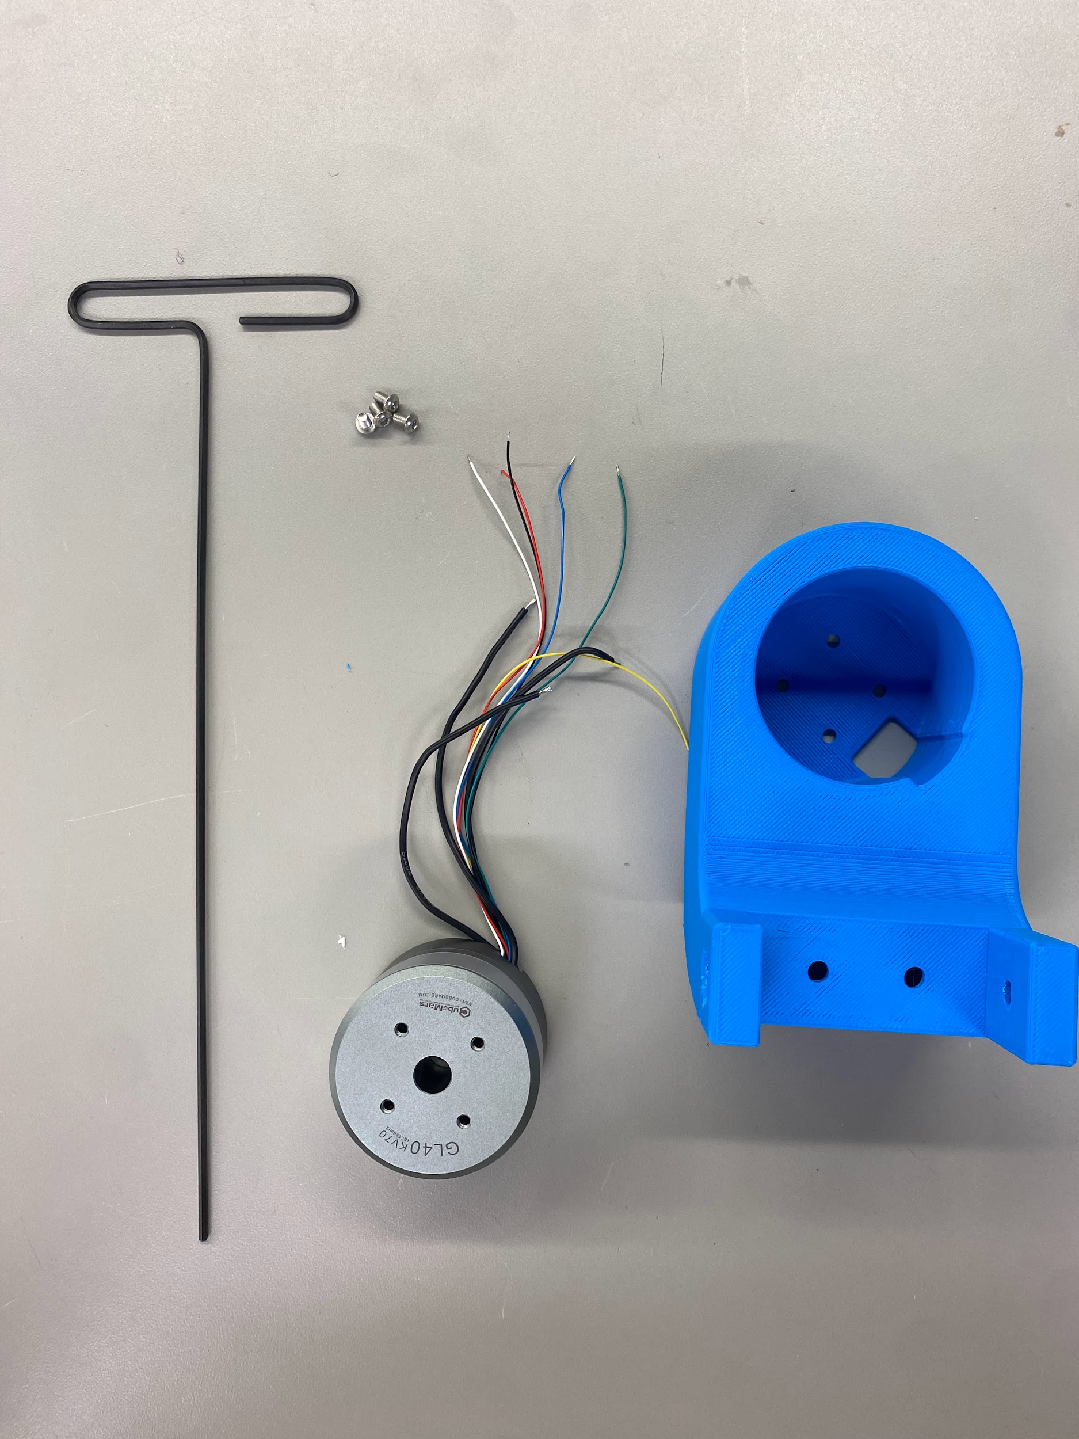
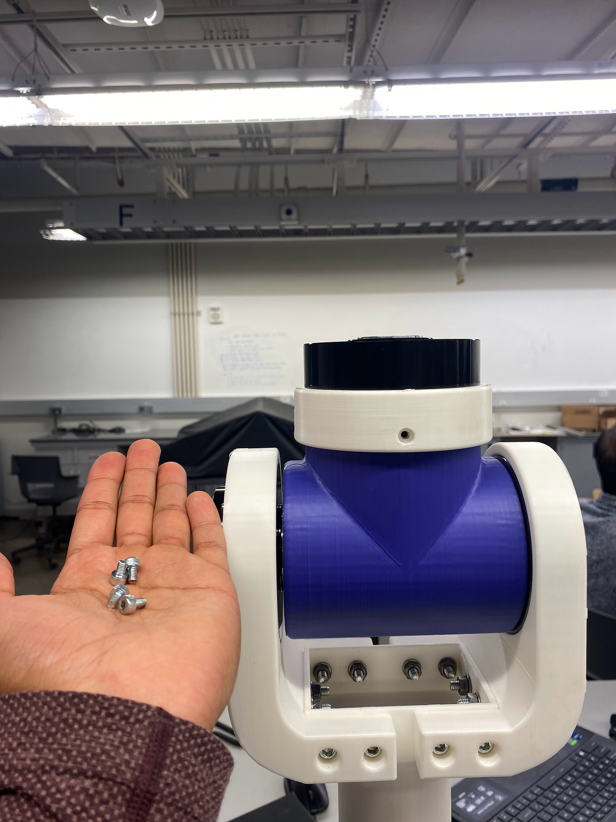
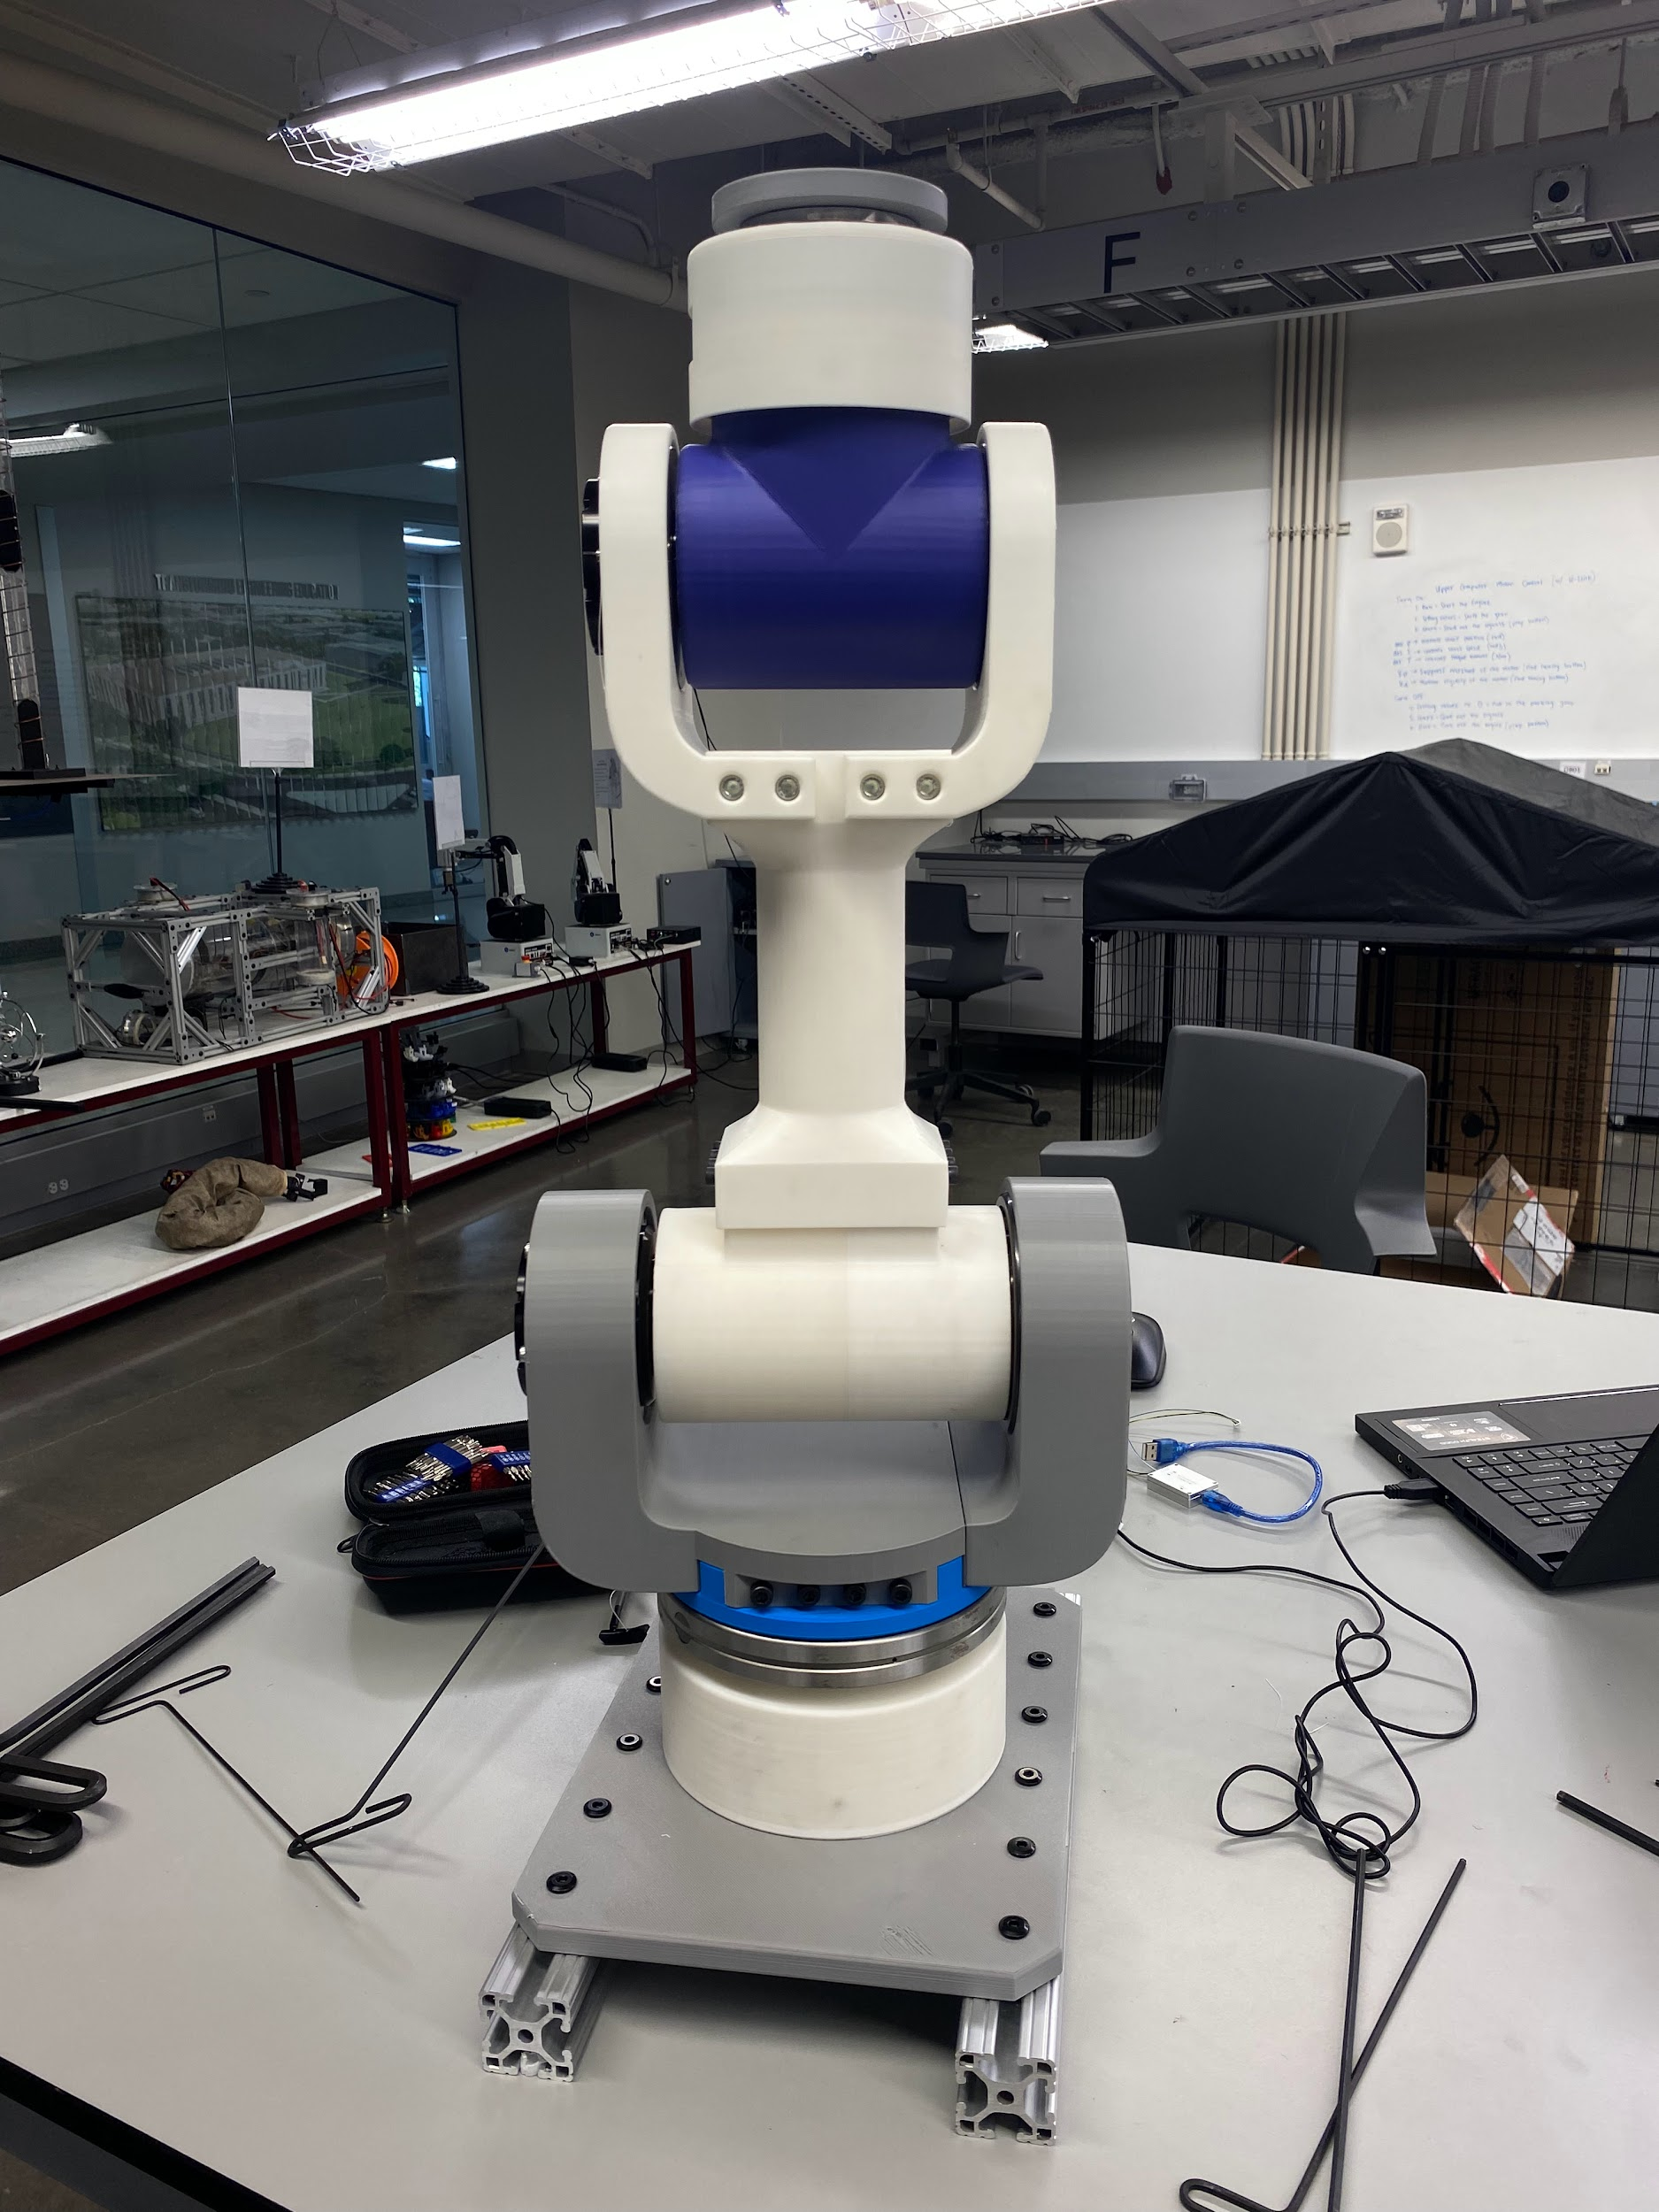
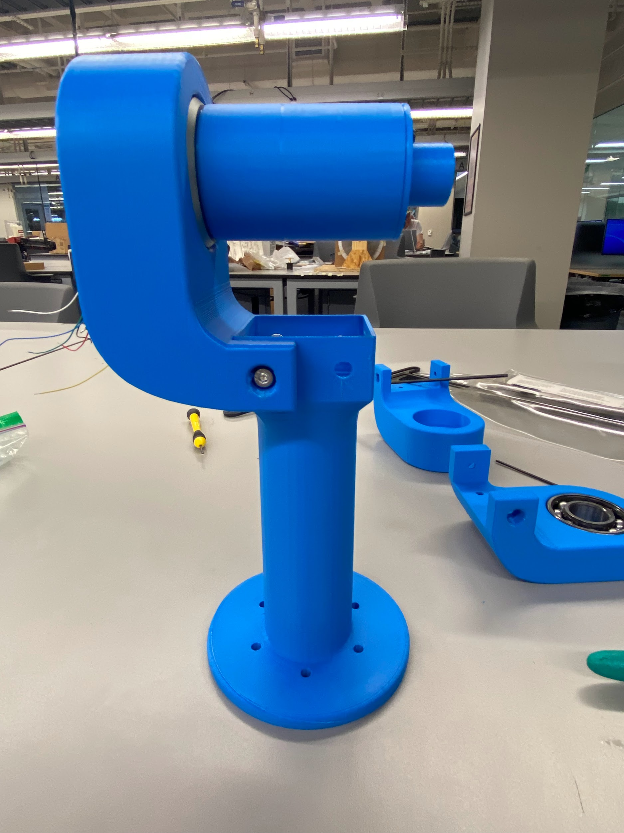
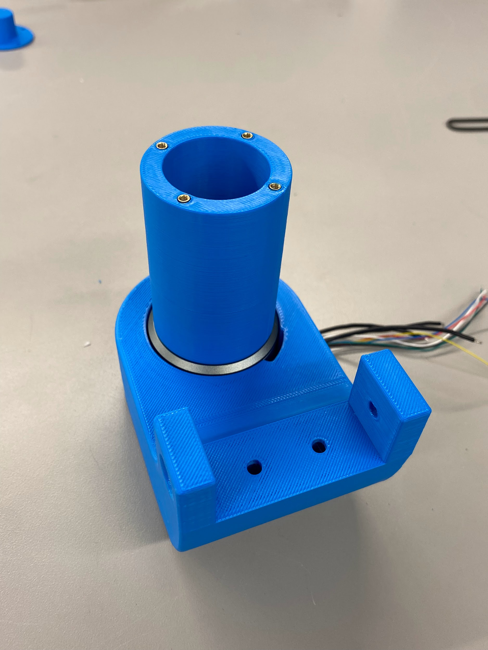
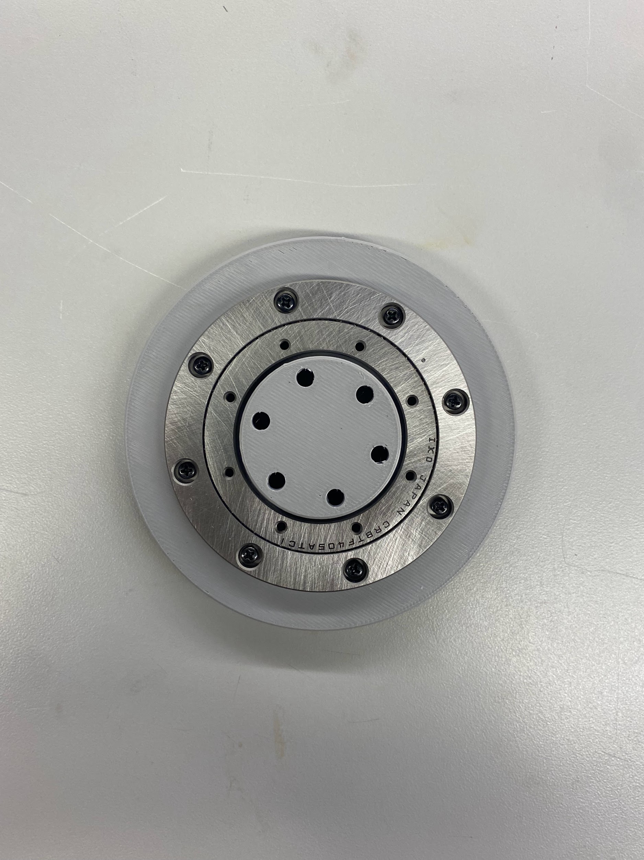
Assembly Manual
Disassembled arm to J2 linkage and reassemble
Took Pictures of every step, to ensure assembly manual is coherent

Slide 12
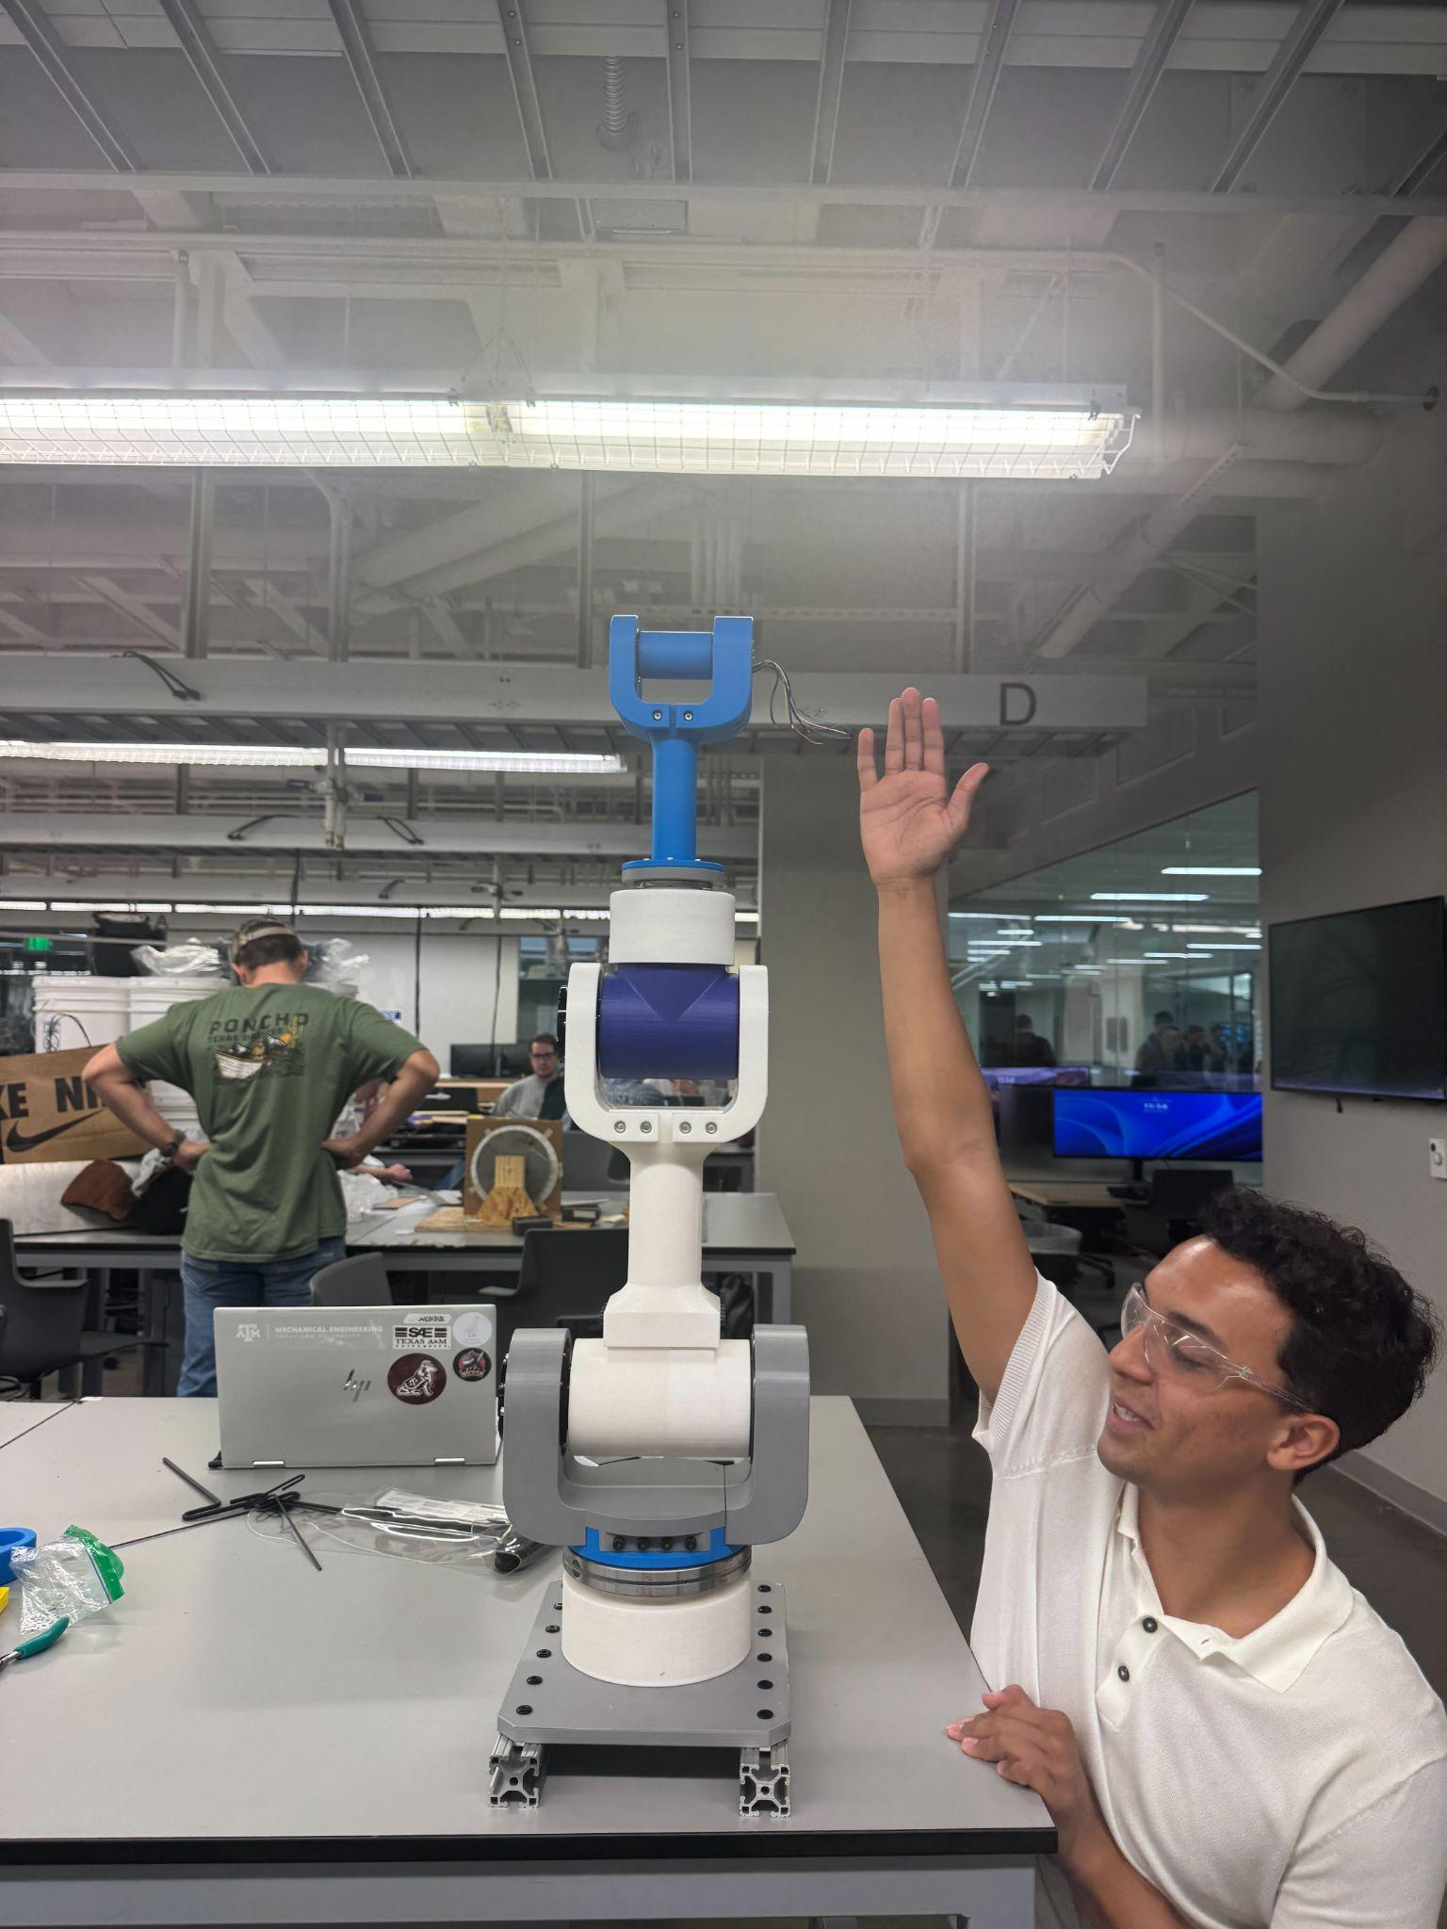
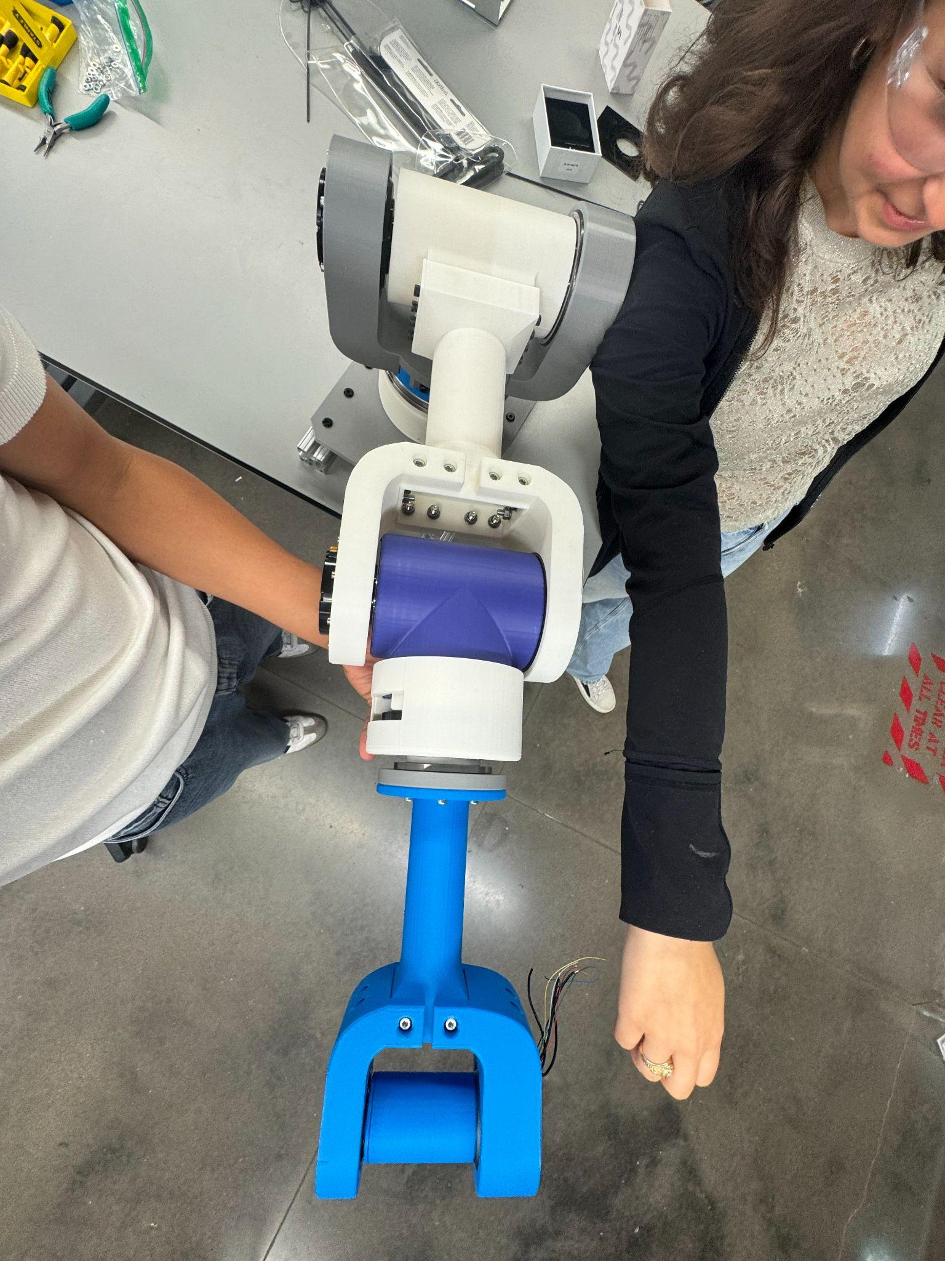
Prototype Assembly
Prototyped Assembly meets our length, and weight requirements outlined in the beginning of our project
Length is .9 m, satisfying the length requirement

Slide 13
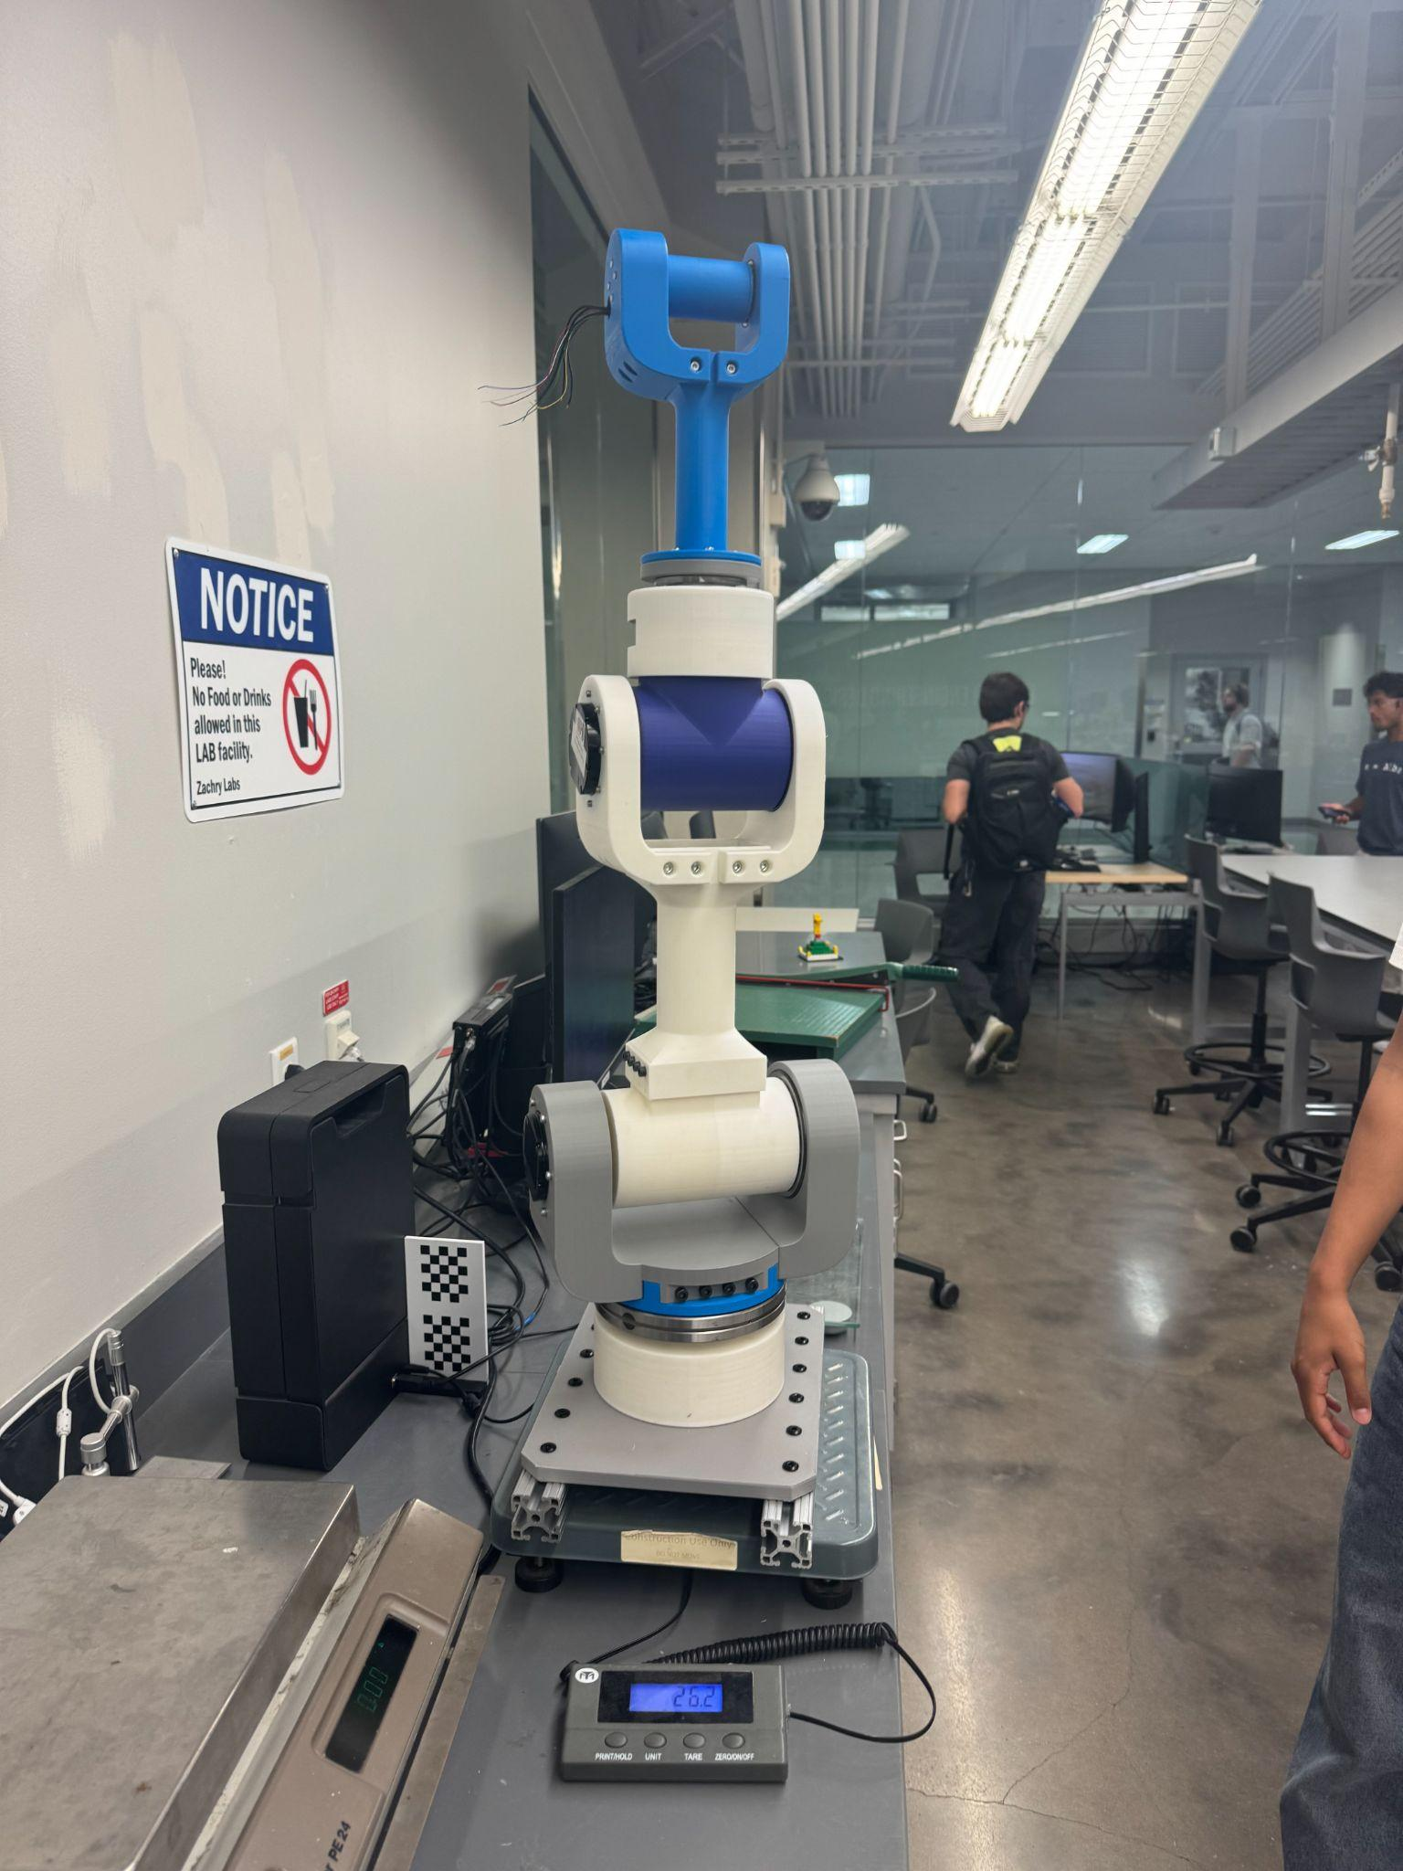
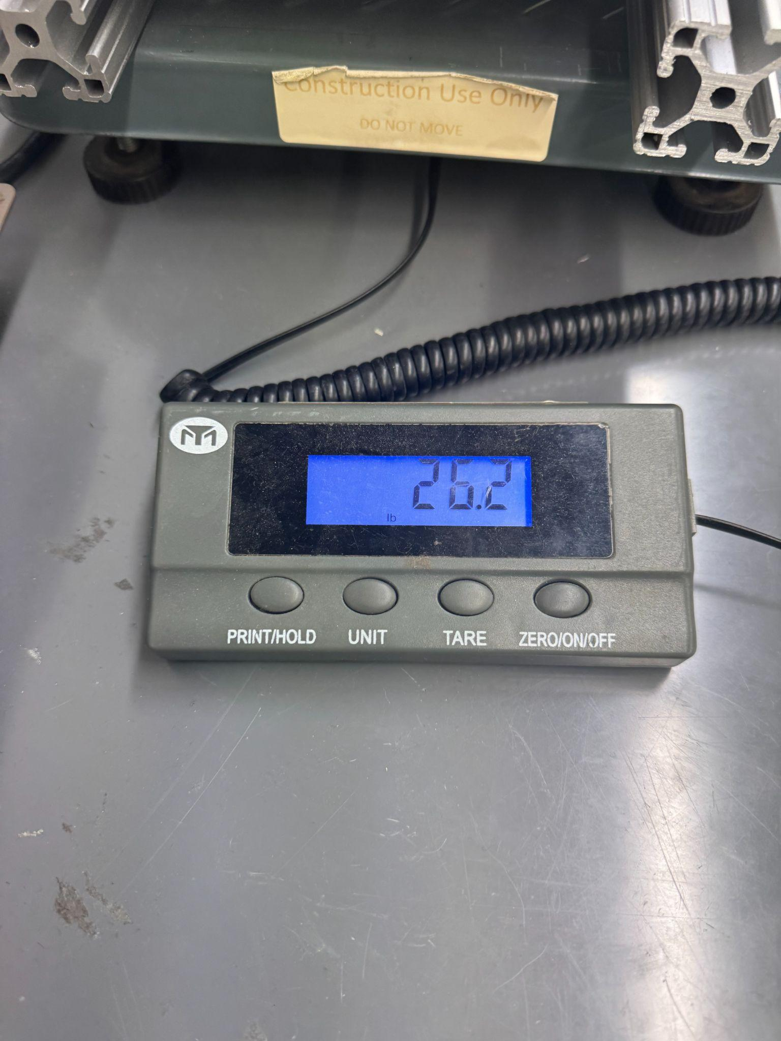
Prototyping/Assembly
Weight Update for assembly
Measured = 26.2 lb
Below our goal of 31 lbs

Slide 14
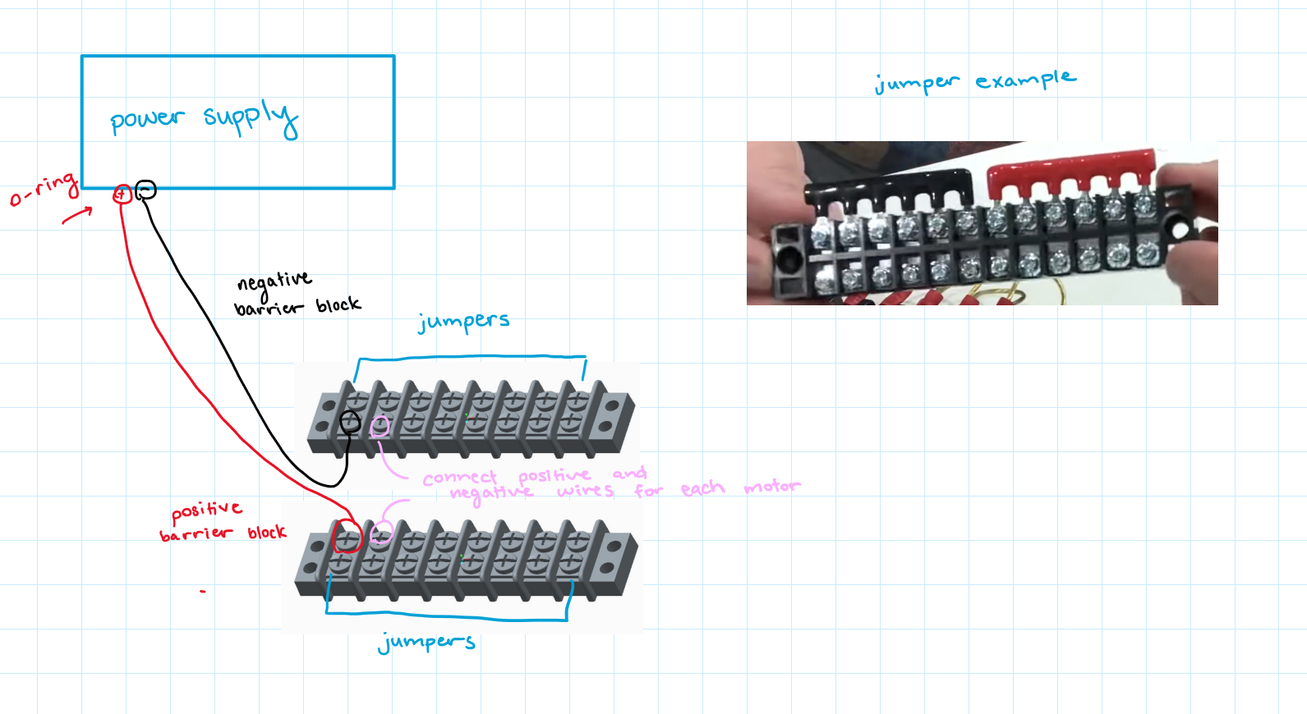
Power Supply Research
Barrier terminal blocks and jumpers will be used to distribute power to each motor.
One terminal block will serve as the negative connection, while the other will be positive.
The components must be rated for 75A and 24V to ensure safe and reliable operation.
The terminal blocks will be securely mounted to the base of our design for stability.

Slide 15
Future Work
Verify electrical components
Test motors from common hub
Continue Assembly Manual changes and updates
Film milestone video
Set up a GitHub repository to streamline and document the assembly process
Create video of comprehensive overview of Capstone project
Final Presentation April 24th 5:00 - 6:00 PM

